Slide 1
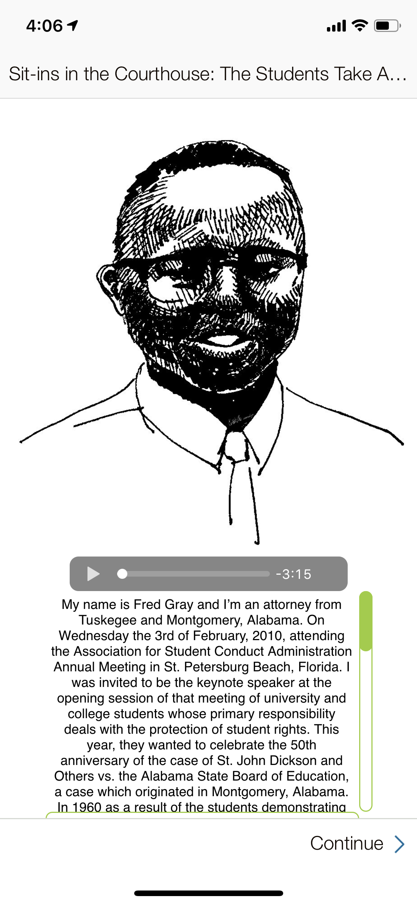
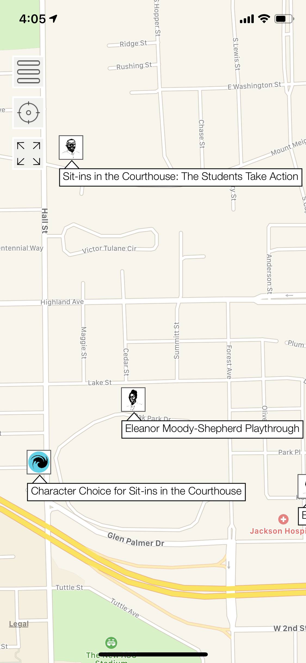
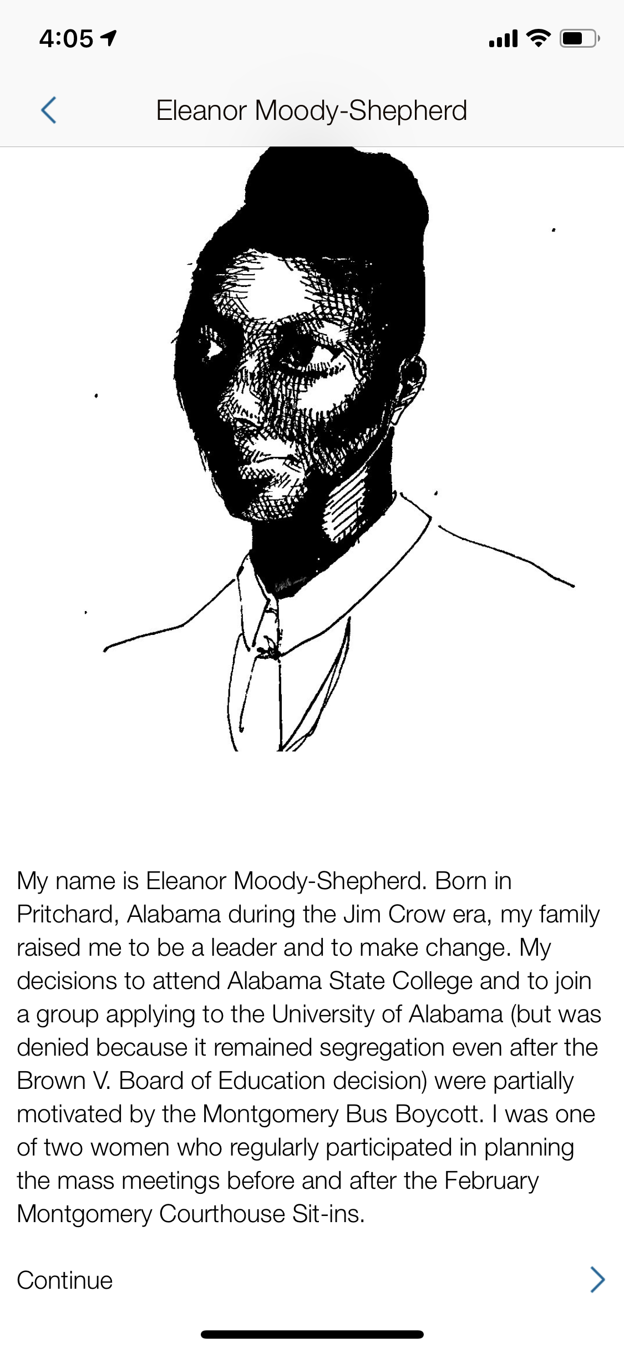


Montgomery 1960: Exploring the Gamification of Moral Comparators in Ethical Education
${\text{Dr}\text{. }\text{Karen} \text{D}\text{. }\text{Boyd}}^{1}$,${ \text{Prof}\text{. }\text{Carolyn} \text{Staples}}^{2}$, ${\text{Brooks} \text{M}\text{. }\text{Leftwich}}^{3}$
University of Tennessee, Knoxville: ¹Educational Leadership and Policy Studies, ²Graphic Design – School of Art, ³Tickle College of Engineering
INTRODUCTION
METHODS
RESULTS
FUTURE RESEARCH
This summer, my team co-designed the game logic and graphic interface for an experiential-learning curricular tool that teaches empathy and perspective-taking (the foundations of ethical and intercultural sensitivity) though immersion into moment in history. I translated my teams' work into a prototype template of the game using the ARIS (Augmented Reality Interactive Storytelling) platform to engage the user in the lived experiences of and challenges faced by the historical events’ participants.
The Fall 2018, Leadership Studies Under/Graduate Research Team began a scholarly literature review investigating the gamification of education, the application of technology in history lessons and in historical contexts, and how history can be and is used to teach perspective-taking and empathy skills.
Our research team partnered with the students of the Spring 2019 ARTD 352 – Intermediate Graphic Design II class to explore concept designs for how the user interface of the game might appear to effectively delivery the historical content. The students completed their work with poster presentations at the Exhibition of Undergraduate Research and Creative Achievement (EURēCA).
The Summer 2019 interdisciplinary Game Design and Production Team made an action plan to create a usable protoype inside ARIS. This included the following: Game Process Design, Front and Back End Computer Programming, Graphic Design Images and Media, Historical Content Analysis and Delivery, and Audio-Visual Production.
We have created a functional ARIS game template that allows for a mix of instructor-guided lessons and free-to-play elements. This mix of game types gives the student the opportunity to take full advantage of the risk-free environment while still maintaining structure and prompting progressions through the lessons. The team organized the historical events into a framework of “Headlines” based on the theoretical dimensions of ethical action proposed by Rest⁹ with the story told through the differing perspectives of the event’s primary historical actors (The Students of the Sit-in, the Governor, and the President of the College). The actors’ stories are presented as moral comparator case studies.
The completed protype sequence follows the primary female student activist as she makes decisions regarding her participation in the student sit-ins at Alabama State College. The art designers generated artwork for the historical comparators and events and our graphic designers visually structured the users’ visual progression through the game. Our computer science team members integrated the audio-visual elements of the historical content into one accessible, seamless screen as seen in the first image below. This sequence will be replicated in communicating the experiences and decisions of additional comparators and serves as a base model for organizing and delivering all event “Headline” content. This content is curated by the whole team to make sure it meets both student and instructor standards.
Over the course of the fall semester, we will streamline the game, eliminate any redundancies, and gather further student input about the user interface and playability of the game. This feedback will help to launch the game into its beta version for testing with the ELPS 351 class during spring 2020. Research team members will continue generating data from historical primary sources to populate the application with moral comparators experiences in the 1960 Alabama State College Student Sit-Ins. Once one scenario is complete, we will examine the classroom relational environment facilitated by this approach and explore how those environmental factors influence ethical development when experienced through technology and a gamified pedagogy. Once the on-campus portions of the project are complete, we look to share the data collection and story-telling theoretical framework, game technology, and creation plans with other universities so they too can make campus specific games to address issues they may be facing or wanting to investigate.
OBJECTIVES
Our ARIS game looks to provide an environment to experience another’s lived leadership challenges while practicing ethical and intercultural leadership skills. Additionally, we seek to design an experiment mechanism to test the effectiveness of gamification in leadership education. Finally, we wish to quantify the effects of empathy and perspective-taking through gamification.
Students develop ethical and intercultural competence when engaged in intentionally structured ethical learning experiences within a caring community that is supportive of self-authored and self-regulated expectations and acts of personal and social responsibility.^{1,2}
Mobile devices have been used in museums to present information to visitors through interactive activities to help expand user experiences³. It has also been proposed and shown that student use of mobile devices in university classrooms is beneficial and desirable to students across multiple cultures⁴.
Empathy is, “a recognition of our humanity in the person of historical actors⁶,” while simultaneously opening, “every door to the possibility that those actors differ from us in ways so profound that we perpetually risk misunderstanding them.” Additionally, intercultural sensitivity and ethics can be gained while teaching in a historical context⁵.
ACKNOWLEDGEMENTS
The Association for Student Conduct Administration
The University of Tennessee Office of Undergraduate Research
Special thanks to those who have collaborated on this work:
Karen D. Boyd, Carolyn Staples, James W. Kemp, Drew Ashby-King, Gregory Croisdale, Khoa Dang, Wenxi Lyu, Ovi Kabir, Wesley Smith, and Takaylan Johnson
REFERENCES
1. Perez, R. J., Shim, W., King, P. M., Baxter Magolda, M. B. (2015). Refining King and Baxter Magolda’s model of intercultural maturity. Journal of College Student Development, 56(8), 759- 776.
2. Narvaez, D. (2006). Integrative ethical education. In M. Killen & J. Smetana (Eds.), Handbook
of Moral Development (pp. 703-733). Mahwah, NJ: Erlbaum.
3. Voet, British Journal of Edu
4. Biddix, J. P., Chung, C. J., & Park, H. W. (2015). The hybrid shift: Evidencing a student-driven restructuring of the college classroom. Computers & Education, 80, 162-175.
5. Kassenoff, M. K., & Meinbach, A. M. (2004). Studying the holocaust through film and literature. Norwood, MA: Christopher-Gordon Publishers.
6. Seixas, P., & Peck, C. (2004). Teaching historical thinking. In A. Sears & I. Wright (Eds.), Challenges and Prospects for Canadian Social Studies (pp. 113). Vancouver: Pacific Educational Press.
7. Nordgren, K., & Johansson, M. (2015) Intercultural historical learning: a conceptual framework, Journal of Curriculum Studies, 47:1, 1-25, DOI: 10.1080/00220272.2014.956795
8. Huijgen, T.,van Boxtel, C., van de Grift, W., Holthuis, P. (2017) Toward Historical Perspective Taking: Students’ Reasoning When Contextualizing the Actions of People in the Past, Theory & Research in Social Education, 45:1, 110-144, DOI: 10.1080/00933104.2016.1208597
9. Rest, J., Narvaez, D., Bebeau, M. J., & Thomas, S., J. (1999). Postconventional moral thinking: A neo-Kohlbergina approach. Mahwah, NJ: Lawrence Erlbaum.
Integrated the audio-visual elements of the historical content into one seamless screen
Interactive map of ASC campus during the time of the sit-in movement
Eleanor Moody-Shepherd game sequence
Leadership Studies Minor

